Slide 1
HER2 targeted therapy has NOT reached its full potential
OPPORTUNITIES:
Goal #1 -- identify more patients who can benefit from HER2 inhibition
Goal #2 – stop tumors from coming back by targeting the drug resistance mechanism
Notes:
Second goal of this study is to reduce the high relapse rates of HER2 positive breast cancer by addressing the therapeutic resistance from HER2 targeted therapy.

Slide 2
Goal 1

Slide 3
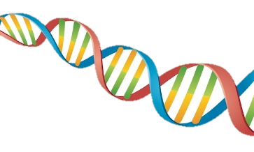
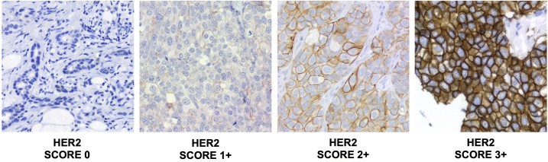
Which patient can receive HER2 targeted therapy?
DNA
Protein
HER2 negative
HER2 positive
Spectrum of HER2 low

Slide 4
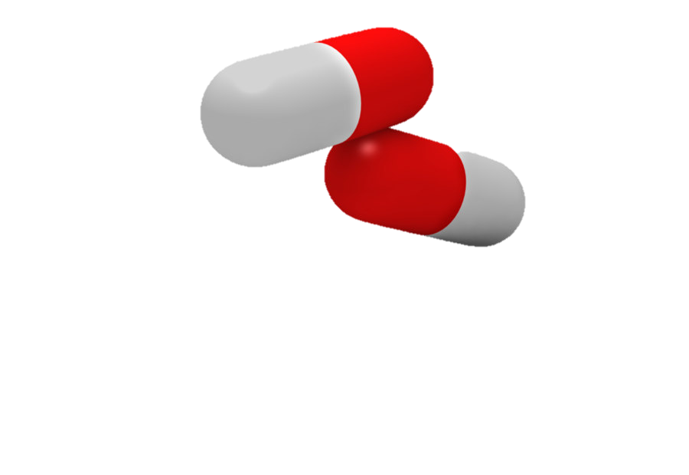
HER2 mutation is NOT qualified for HER2 targeted therapy
Normal cell
HER2 mutated cell
?
HER2
HER2*

Slide 5
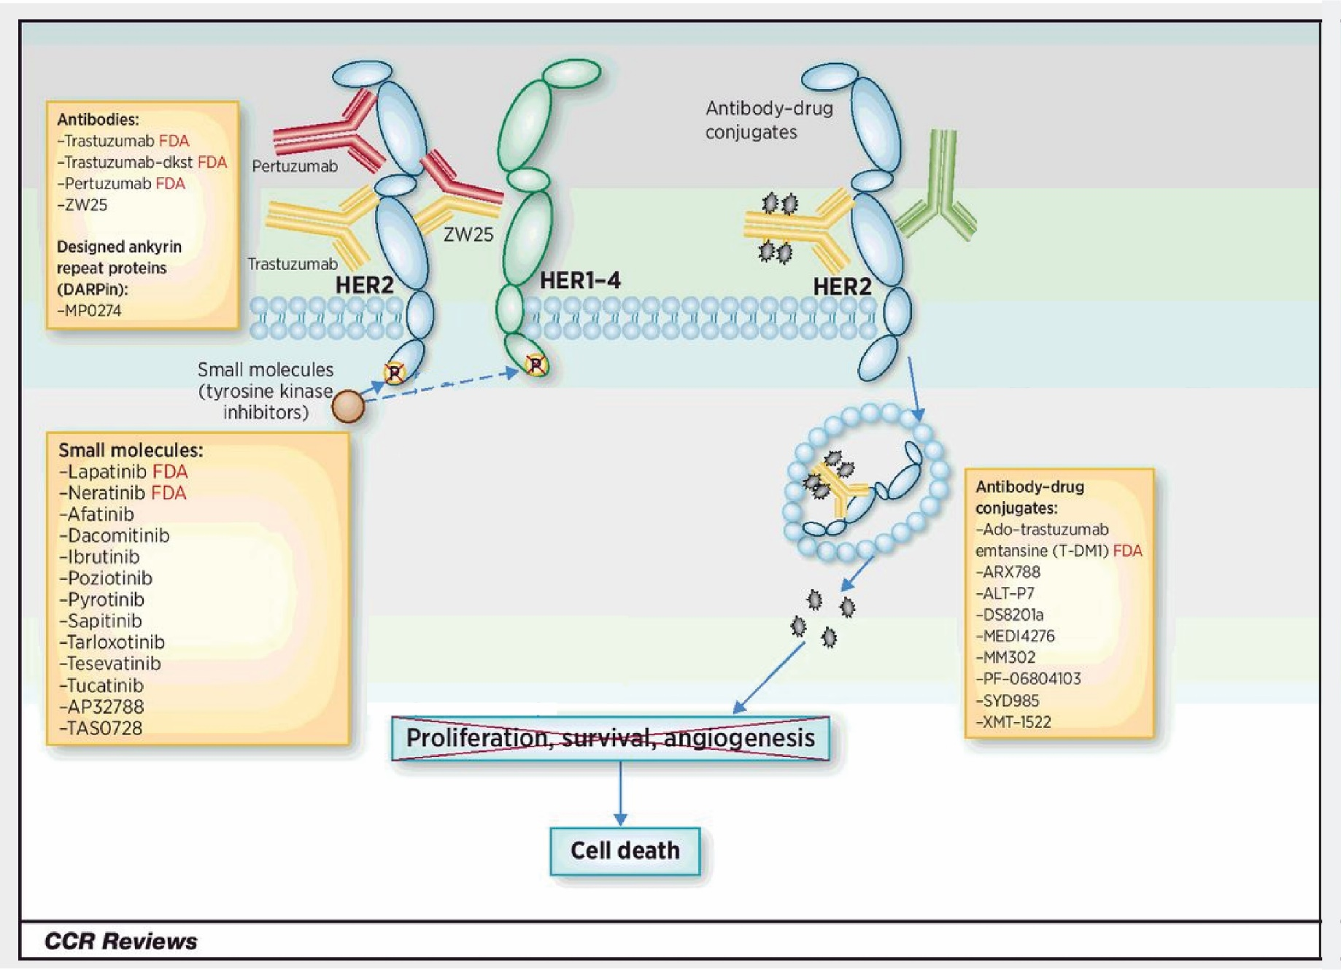
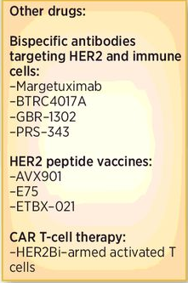

We need to match HER2 mutation with the BEST drug
Notes:
These mutations could also be the third marker to select patients for HER2 targeted therapy.
It takes months and more than a thousand dollars to synthesize a single mutant clone, which is why we only studied so few of them.
Our lab has an unique advantage to conduct this type of large scale genetic studies because I developed a high-throughput cloning platform that allows us to make all the 130ish mutations in a month with less than 1/10 of the cost. I am going to talk more about this platform in the later part of the presentation.

Slide 6
Methods
Mutation data for 6,664 breast cancer patient samples were downloaded from cBioPortal (1,2) across a total of 13 breast cancer studies (3–15). At the time of download, the public cBioPortal used the hg19/GRCh37 version of the reference genome. Mutations in cBioPortal are assumed to be on the (+) strand unless otherwise noted by dataset depositors.
A total of 97 ERBB2 alterations across 222 samples were collected, including single nucleotide polymorphisms and small insertions and deletions. We required SNPs to be missense or splice-site and included both frame- shift and in-frame alterations.

Slide 7
Goal 2

Slide 8

How do the persister cells survive treatment?
Temporal survival
Long-term resistance
Early intervention
Apparent tumor regression
And treatment
Relapse rate
Tumor relapse
Longer patient survival
Drug-sensitive cell
Metastatic /
Therapy-resistant tumor
Drug-resistant cells

Slide 9
Amplified
genes
Overexpressed
genes
C
Upregulated genes in
patients with > 3 year survival
A
B
Stratify by
survival data
Candidate genes
for HER2+ inhibitor resistance mechanisms
E
HER2+ cohort
Amplified
genes
Overexpressed
genes
D
Upregulated genes in
patients with < 3 year survival

Slide 10
103 genes total

Slide 11
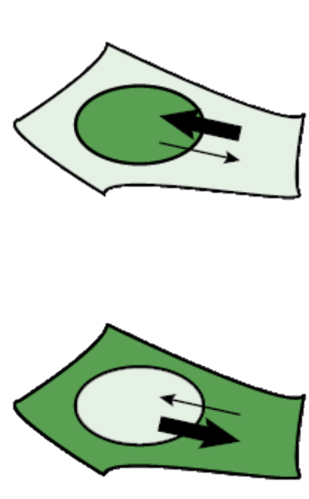
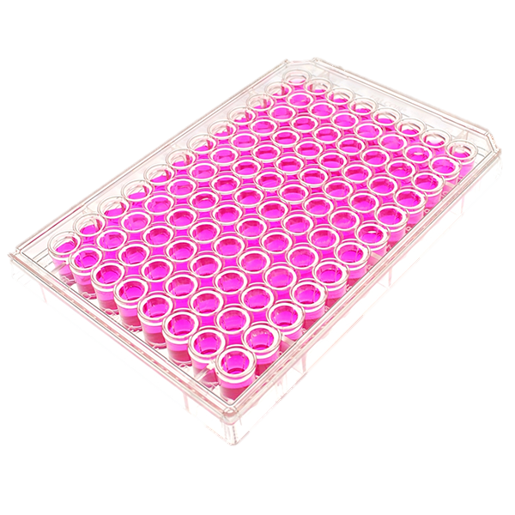
Pharmacodynamics imaging
Translocation reporter
Reporter 1
nucleus
Reporter 2
Active
Inactive
Notes:
I built this pharmacodynamics imaging system aiming to track drug response. This system has two key components – a collection of translocation reporters which shuffle between cytoplasm and nucleus based on drug activity, and a fully automated cell imaging system that can continuously scan the entire 96 well plate for days. Each well here contain a unique cell samples, they can be cells expressing different HER2 mutations or resistant gene drivers, or they can be cells under different treatments.
To facilitate data analysis, we also developed a customized algorithm to transform terabytes of images into analyzable figures for further interpretation.

